Slide 1
Greybox fuzzing withML

Slide 2
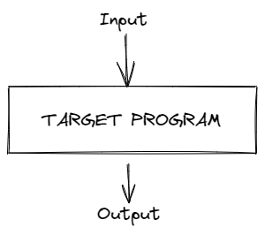
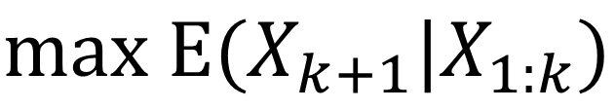
Problem:
Find more bugs with a time limit.
How to choose inputs that maximize the probability of triggering a bug.
$$max E(X_{k+1}|X_{1:k})$$

Slide 3
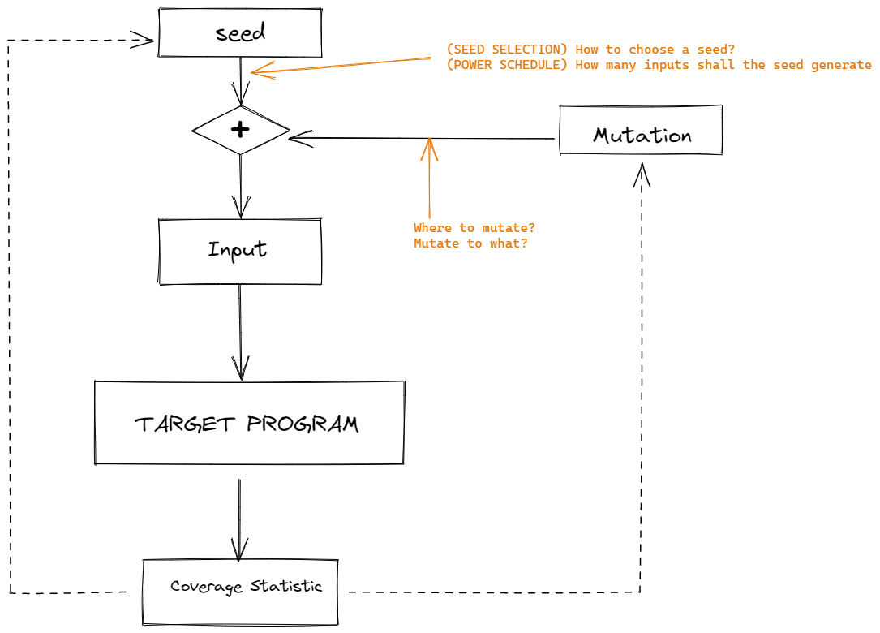
How does Coverage Guided Greybox Fuzzing work?
Intuition:
We have more chances in less explored areas
Model the probability of finding a bug as coverage gain.
Observation:
Most input exercise only a few paths

Slide 4
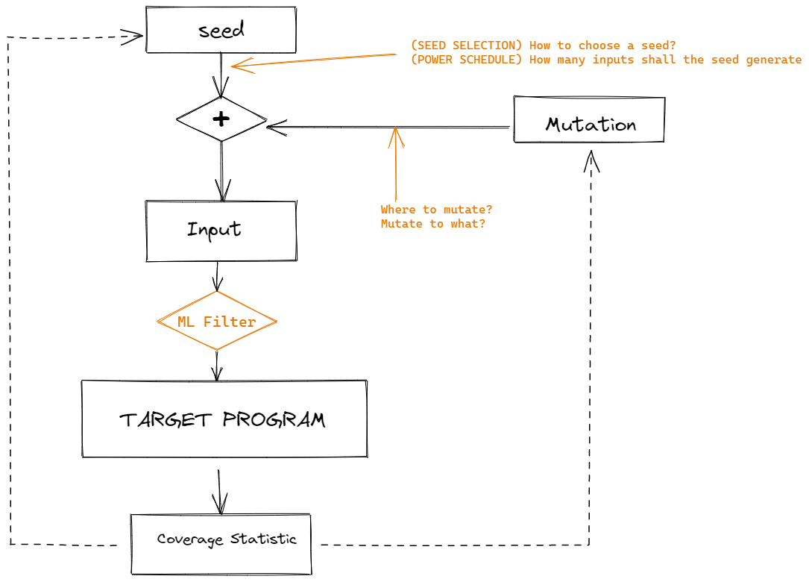
User less inputs to exercise more paths

Slide 5
Challenges
Hard to choose/model the input and response.
Coverage, structured input, execution time, context/stack
Difficult to give a distance on inputs.
How to use the call graph
The problem is discrete, or even not continuous
magic bytes…
The target probability is not static
Can’t afford a too complicated model.
Training set might be biased.
Sometimes a good precision may result in bad performance.

Slide 6
Some related works using ML
Predict the position of bytes that can affect a branching.
For each edge, predict the probability an input may exercise that branch.
Generate a model of the input.

Slide 7
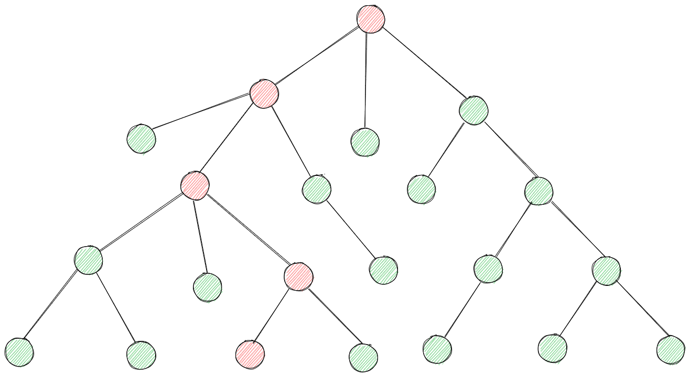
Use part of the target program as a filter?

Slide 8
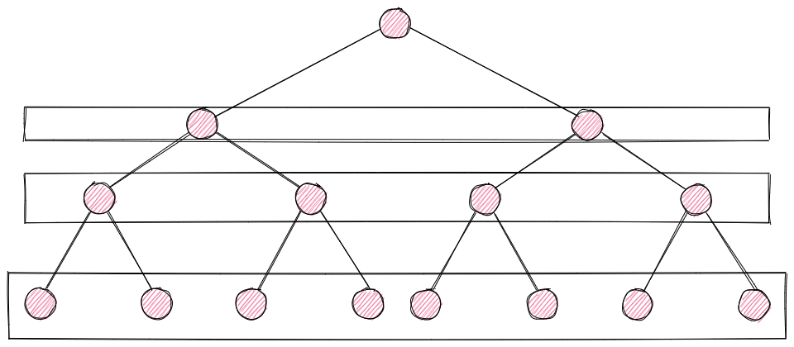
Avoid trap around a deep path:
early stop? Give/Predict a weight on nodes/edges.
given an input pass through edge e1, e2, e3, …. , if we should let it pass this edge.
Can the graph give a suggestion of the architecture of the NN?

